Slide 1
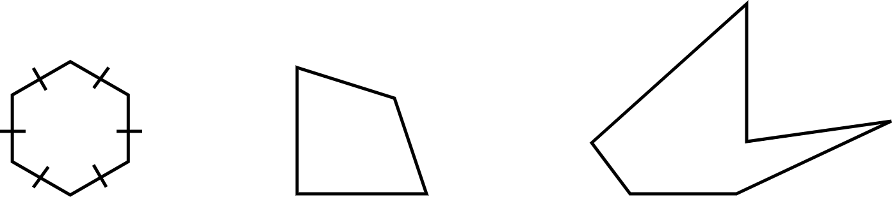
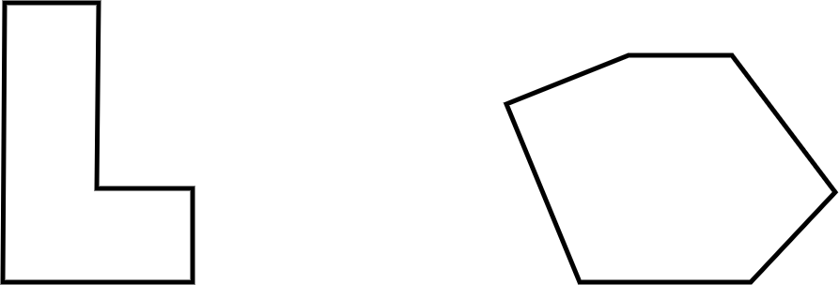
Finding the perimeter of polygons
Task A: Efficiently calculating perimeter
1) Calculate the perimeter of each polygon. Evaluate your approach and determine if you could be more efficient.
a) b) c)
d) e)
5 cm
7.5 in
5.3 in
3 mm
4 cm
5 cm
4.4 in
2 in
6 in
4 cm
3 in
2 ft
5.2 m
3.7 m
4 ft
9.8 m
6 ft
2 ft
11.3 m
2 ft
6.4 m
4 ft
8.6 m
E.g. For A
Perimeter = 3 × 6
= 18 mm
This is more efficient than repeated addition as there are less steps in the overall calculation.
E.g. For B
Perimeter = 2(4 + 5)
= 18 cm
This is more efficient than repeated addition as there are less steps in the overall calculation.
This is more efficient than 2 × 4 + 2 × 5 as my way involves two steps, rather than three.
E.g. For C
Perimeter = 2 + 3 + 6 + 4.4 + 5.3 + 7.5
= 28.2 in
I could not see a more efficient way as I could not spot any useful number bonds nor could I use multiplication in place of repeated addition.
E.g. For D
Perimeter = 2 × (6 + 4)
= 20 ft
I could see lots of ways to work this perimeter out. I realised there were two lots of 6 and two lots of 4 so I used the distributive law to be more efficient.
E.g. For E
Perimeter = 15 × 3 I spotted that 8.6 and 6.4 sum to 15.
= 45 m I then saw 5.2 + 9.8 = 15 and 11.3 + 3.7 = 15.
I then realised I had 3 lots of 15.

Slide 2
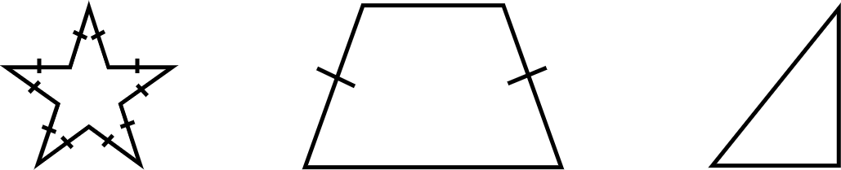
Finding the perimeter of polygons
Task B: Using formulas for perimeter
1) a) Match the shape to a formula that could be used to find its perimeter.
P = a + 2b + c
P = t + r + w
P = 10k
b) Calculate the perimeter of each shape using your chosen formula.
3.4 cm
5 cm
6 cm
5 cm
4 cm
8 cm
3 cm
P = 10k
= 10 × 5
= 50
Perimeter is 50 cm
P = a + 2b + c
= 3.4 + 2 × 6 + 8
= 23.4
Perimeter is 23.4 cm
P = t + r + w
= 5 + 3 + 4
= 12
Perimeter is 12 cm
c) Consider each answer. Was the formula useful?
E.g.
The formula for the star was helpful as I didn’t have to do lots of addition.
The formula for the isosceles trapezium was sort of helpful as it was only doubling one value.
The formula for the triangle was not helpful as it was the same as just adding.
Mathematics in Education and Industry.

